Slide 3
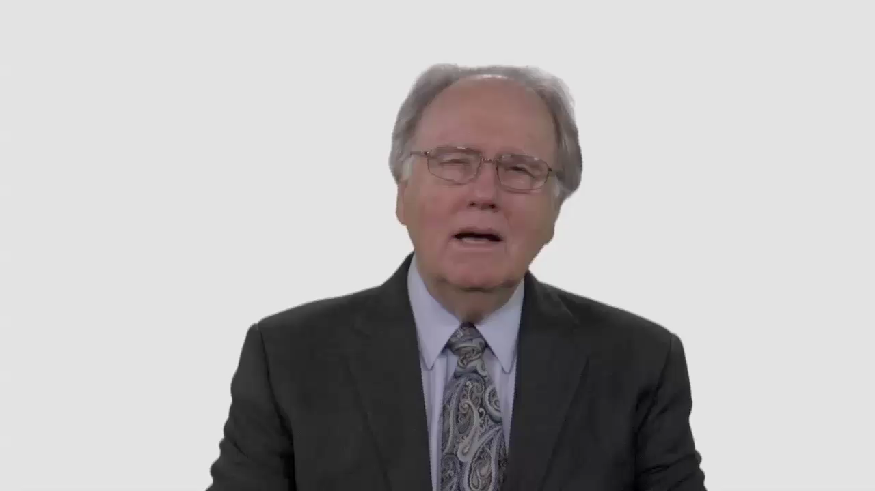

Slide 4
Have Your Say.
How would your congregation
react to having a woman
as a senior pastor?

Slide 5
Conversation Builders.
Beyond what you find in Scripture,
do you think other influences have helped shape your feelings
about women’s ordination?

Slide 6
Conversation Builders.
Is it helpful or unhelpful
to frame the discussion of
women in ministry in terms of
“Christ” versus “culture”?

Slide 7
Conversation Builders.
What happens during an ordination service? Does our understanding
of this make a difference in our discussion of women’s ordination?

Slide 8
Discussion Questions.
Do you think the unity of the worldwide Adventist Church
depends on sharing one approach
on the issue of women’s ordination?

Slide 9
Discussion Questions.
Would ordaining women in your
area boost or harm your
church’s ability to do mission?

Slide 10
Discussion Questions.
When talking about women’s ordination, do we tend to belittle
those who disagree with us?
Does this make it harder to
find common ground?

Slide 11
Discussion Questions.
How could you encourage a
young person who says, “I’m
tired of waiting for my church to
get itself together on this issue”?

Slide 12
What Now?
Could your local church become
more inclusive when it comes to women in ministry leadership?

